Slide 1
CN⁻ and OCN⁻ formation by NSRRC and MDHL and Flux calculations
Lily Leung

Slide 2
Correction for difference in aperture and IR band
IR band: 3.5 mm(H) x 10 mm(W)
VUV band: 3 mm(H)x 7 mm (W)
IR yield for products * for 0.35/0.21 =1.667

Slide 3
CN⁻: Corrected IR beam size

Slide 5
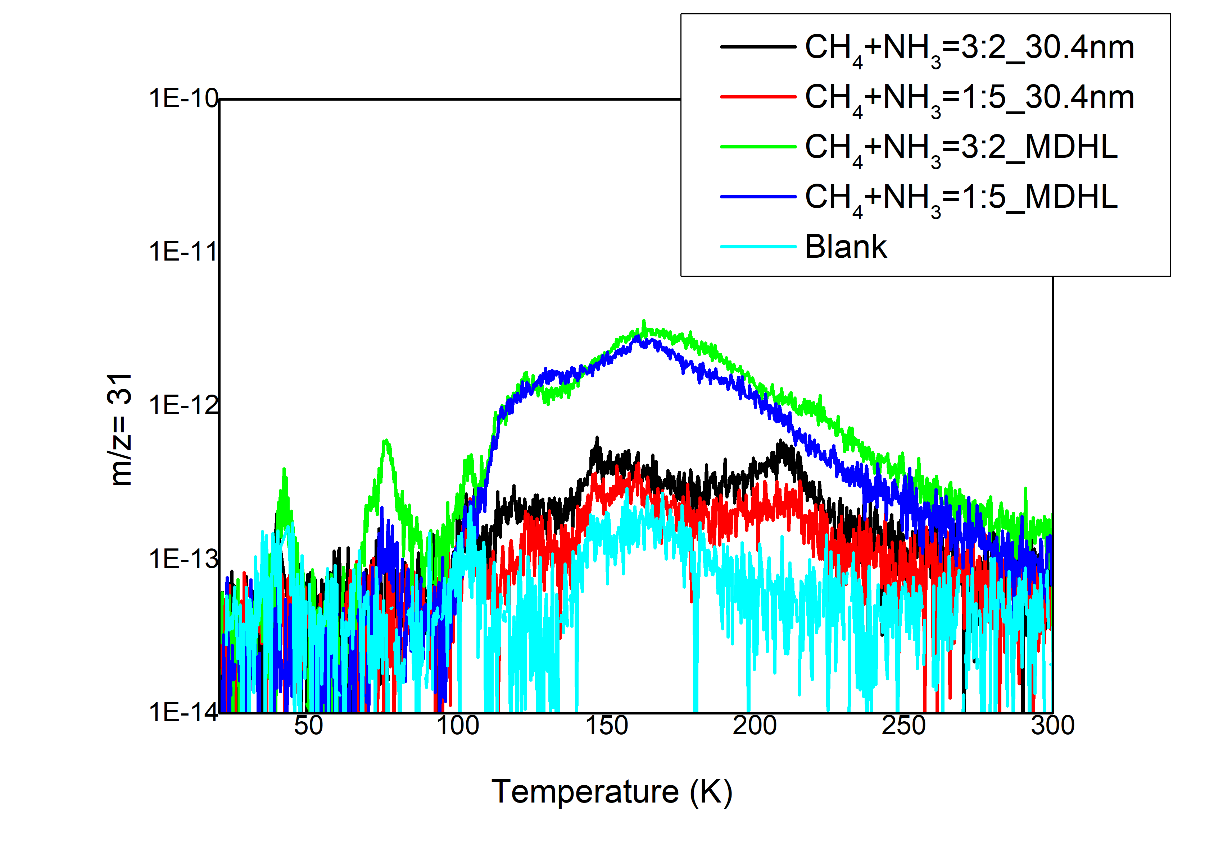
Missing CH₃NH₂
30.4nm:
one step mechanism

Slide 6
OCN⁻: Corrected IR beam size

Slide 8
Problem: Ni-mesh value drops
At first few irradiation
1.8e-9
2.3e-9
Lower current
Max also changes

Slide 9
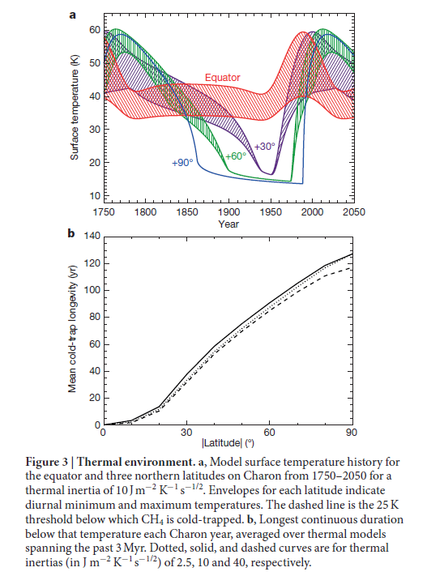
CH₄ deposition time
130 years (2.7 x 10¹¹ molecules m⁻² s⁻¹)
Accumulated only 45º
3.45 times faster
If constant rate
380 ML deposited on pole
190 ML on 45º

Slide 10
VUV Flux
VUV Lyα (dark)= 3.57 x 10 ¹² eV m⁻² s⁻¹
130 years =1.46 x 10 ²² eV m⁻²
MDHL flux = current * Q-factor *average energy (9.27)
=4.92 x 10¹⁴ eV cm⁻² s⁻¹
=4.92 x 10¹⁸ eV m⁻² s⁻¹
MDHL 44.5 min = 130 years VUV Lyα (dark)
VUV Ly α(bright) = 1.9 x 10 ¹³ eV m⁻² s⁻¹
=7.79 x 10 ²² eV m⁻²
MDHL 270 min = 130 years VUV Lyα (bright)

Slide 11
EUV flux
EUV (bright)= 8.7 x 10 ¹¹ eV m⁻² s⁻¹
=6.8 x 10 ²¹ eV m⁻² for 248 years (1 pluto year)
By Ni-mesh reading* Q-factor/Beam size (0.21cm²)*energy of photon (40.78 eV)*10⁴
Q factor= 2.914 x 10²¹
NSRRC 30.4nm =7.69 x 10 ¹⁹ eV m⁻² s⁻¹
1 pluto year = 1.47 min irradiation

Slide 12
CN⁻

Slide 13
Conclusion
By absense of methylamine, we may know that the reaction mechanism of CN- is one step in EUV irradiation
The Ni-mesh problem in water added ice mixtures (use CH₄+NH₃ experiments?)
The maximum CN⁻ formation on different latitudes on Charon is found.

